Slide 1

GENEALOGY SPREADSHEET

Slide 2
AGENDA
Steps
  Find all the information available for the individual you are pursuing and their family
  Prepare a family group sheet of this individual to refer to when trying to locate documentation.
  Start your spreadsheet with the individual you are pursuing and enter all pertinent information
  Start the next available column with all the information about the individual most likely to lead you to a successful conclusion. In my case, this was Garret Marsh.
  Records found for Harrison Marsh
  Records found for George W. and Ettie Marsh

Slide 3
PURPOSE
The purpose for the spreadsheet I set up was to find the ancestors of my Great Grandmother Cynthia Ann (Marsh) Killian. I had been told by my mother than she was adopted. Therefore, I didn’t know whether Marsh was her birth or adopted name. The epiphany moment in finding her ancestors came with a newspaper article stating that Joseph Killian (Cynthia’s son) hosted his Uncle George Marsh and cousin Garret Marsh from Portsmouth, Ohio. That would make Uncle George Cynthia’s brother and I now had a starting point! Since Garret is an unusual name for that time frame, I pursued him in the records. After finding all the records I could find, I still wasn’t sure of Cynthia Ann’s parents. So, I set up a spreadsheet with all available information. Let’s start setting up our spreadsheet.

Slide 4
STEP 1: Find all the information available
Census Records
Birth, Marriage and Death Records
Find A Grave memorials
Social Security information
Etc.

Slide 5
Step 2: GATHER ALL YOUR RECORDS
Enter all the information found in the first column on the spreadsheet
  Birth Record
  Marriage Record
  Death Record
  Etc.

Slide 6
STEP 2: Marriage Record

Slide 7
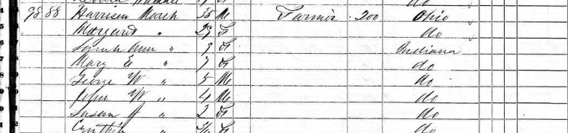
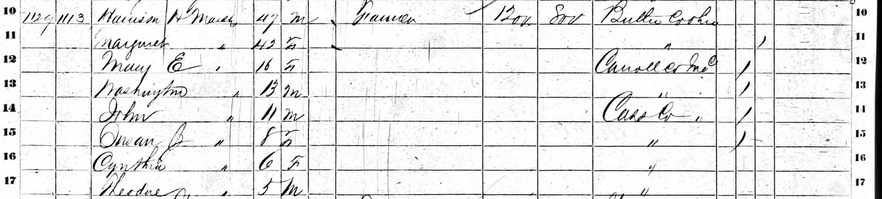
STEP 2: Census Records
  1850 Cass County, IN
  1860 Cass County, IN

Slide 8
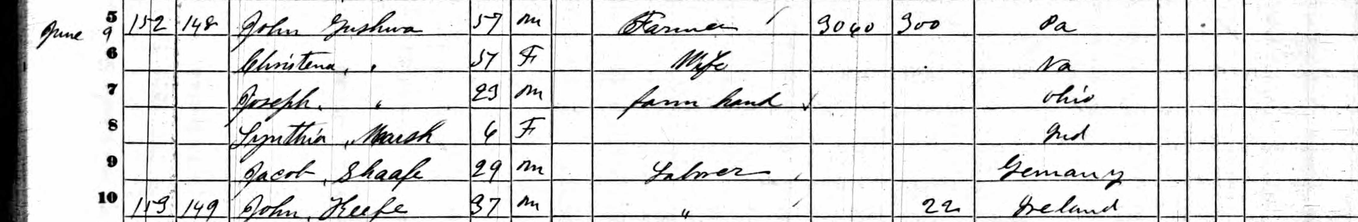
STEP 2: Census Records
Duplicate Residency
  1860 Tippecanoe County, IN
Notes:
These census records indicate Cynthia Ann Marsh in another household. For whatever reason, Cynthia left her birth family and moved in with the Gushwa family. This would account for my mother saying Cynthia was adopted.

Slide 9
STEP 2: Census Records
1870 Census – Tippecanoe County, IN

Slide 10
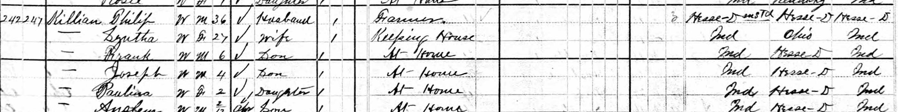
STEP 2: Census Records
1880 Census – Tippecanoe County, IN

Slide 11
STEP 2: DEATH RECORD

Slide 12
STEP 2: Any other miscellaneous information found

Slide 13
STEP 2: Prepare family group sheet

Slide 14
STEP 2: Spreadsheet Entries

Slide 15
STEP 3: Start the next available column with all the information about the individual most likely to lead you to a successful conclusion.
In my case, this was Garret Marsh.
Locate this individual’s parents through the appropriate records
Enter all the information found on your spreadsheet
  U. S. Social Security Application
  Marriage Record
  1880 Census
  1900 Census
  1910 Census
  1920 Census
  1930 Census
  Railroad Retirement Record
  Find A Grave Information

Slide 16
STEP 3: U. S. Social Security Applications

Slide 17
STEP 3: Marriage Record

Slide 18
STEP 3: Census Records
1880 Census – Pickaway County, Ohio
1900 Census – Scioto County, Ohio

Slide 19
STEP 3: Census Records
1910 Census – Ross County, OH
1920 Census – Scioto County, OH
1930 Census – Scioto County, OH

Slide 20
STEP 3: U. S. Railroad Retirement Pension Index

Slide 21
STEP 3: Find A Grave

Slide 22
STEP 3: FAMILY GROUP SHEET

Slide 23
STEP 3: Spreadsheet Entries
George Washington Marsh
Born |  | Indiana | 1842-1847
Died |  | Scioto County, Ohio | 22-Jan-1926
Married | Mariah Walling |  | bef 7 Mar 1872
Children | Garrett Lafayette | Locus Grove, Adams County, Ohio | 7 Mar 1872
 | Sarah Ella | Licking County, Ohio | 2 Jan 1874
 | John W. | Licking County, Ohio | 1 Nov 1884
 | Mary Ann | Licking County, Ohio | 11 Jan 1889
1880 Census - Perry Township, Pickaway County, Ohio
George | 38 | Indiana-Indiana-Indiana
Maria | 28 | Ohio-Ohio-Ohio
Garrett | 8 | Ohio-Indiana-Ohio
Ella | 5 | Ohio-Indiana-Ohio
1900 Census - Valley Township, Scioto County, Ohio
George W. | 53 | Indiana-Ohio-Ohio | b. Jan 1843
Mariah | 50 |  | b. Dec 1849
Garrett L. | 28 | Ohio-Indiana-Ohio | b. Mar 1872
John W. | 16 | Ohio-Indiana-Ohio | b. Nov 1883
Anna | 11 | Ohio-Indiana-Ohio | b. Jan 1889
1910 Census - Valley Township, Scioto County, Ohio
George W | 63 | Indiana-Ohio-Ohio
Mariah | 60 | Ohio-Ohio-Ohio
Ohio Death Records, 1908-1932, 1938-2018
George W. | d. 22 Jan 1926 | Scioto County, Ohio
Find A Grave
George W | b. 15 Jan 1843 | Lafayette, Tippecanoe County, IN
 | d. 22 Jan 1926 | Lucasville, Scioto County, Ohio
Maria S. | b. 1848
 | d. 1924 | Lucasville, Scioto County, Ohio
Anna Dever | b. 11 Dec 1888 | Scioto County, Ohio | Daughter
 | d. 3 Nov 1924 | Portsmouth, Scioto County, Ohio
Notes:
Now that we have determined Garrett Lafayette Marsh is the son of George W. and Mariah (Walling) Marsh. We go looking for the records for George Washingto Marsh.

Slide 24
STEP 4: Records for George Washington Marsh
Ohio Death Record for George W. Marsh

Slide 25
STEP 4: Census Records
1910 Census – Scioto County, OH

Slide 26
STEP 3: Find A Grave for George W. Marsh

Slide 27
STEP 3: FAMILY GROUP SHEET

Slide 28
STEP 3: Spreadsheet Entries
George Washington Marsh
Born |  | Indiana | 1842-1847
Died |  | Scioto County, Ohio | ######
Married | Mariah Walling |  | bef 7 Mar 1872
Children | Garrett Lafayette | Locus Grove, Adams County, Ohio | 7 Mar 1872
 | Sarah Ella | Licking County, Ohio | 2 Jan 1874
 | John W. | Licking County, Ohio | 1 Nov 1884
 | Mary Ann | Licking County, Ohio | 11 Jan 1889
1880 Census - Perry Township, Pickaway County, Ohio
George | 38 | Indiana-Indiana-Indiana
Maria | 28 | Ohio-Ohio-Ohio
Garrett | 8 | Ohio-Indiana-Ohio
Ella | 5 | Ohio-Indiana-Ohio
1900 Census - Valley Township, Scioto County, Ohio
George W. | 53 | Indiana-Ohio-Ohio | b. Jan 1843
Mariah | 50 |  | b. Dec 1849
Garrett L. | 28 | Ohio-Indiana-Ohio | b. Mar 1872
John W. | 16 | Ohio-Indiana-Ohio | b. Nov 1883
Anna | 11 | Ohio-Indiana-Ohio | b. Jan 1889
1910 Census - Valley Township, Scioto County, Ohio
George W | 63 | Indiana-Ohio-Ohio
Mariah | 60 | Ohio-Ohio-Ohio
Ohio Death Records, 1908-1932, 1938-2018
George W. | d. 22 Jan 1926 | Scioto County, Ohio
Find A Grave
George W | b. 15 Jan 1843 | Lafayette, Tippecanoe County, IN
 | d. 22 Jan 1926 | Lucasville, Scioto County, Ohio
Maria S. | b. 1848
 | d. 1924 | Lucasville, Scioto County, Ohio
Anna Dever | b. 11 Dec 1888 | Scioto County, Ohio | Daughter
 | d. 3 Nov 1924 | Portsmouth, Scioto County, Ohio
Garrett | M
Nelle | 1883-1966
Herbert | 1909-1958 | s/o Garrett and Nelle
Beulah | 1923- | w/o Herbert
Notes:
Now that we know the parents of Garrett Lafayette Marsh are George Washington and Mariah (Walling) Marh, we need to find the parents of George and Cynthia and we find them with Harrison and Margaret (Harper) Marsh.

Slide 29
STEP 4: Records found for Harrison Marsh
Marriage Record

Slide 30
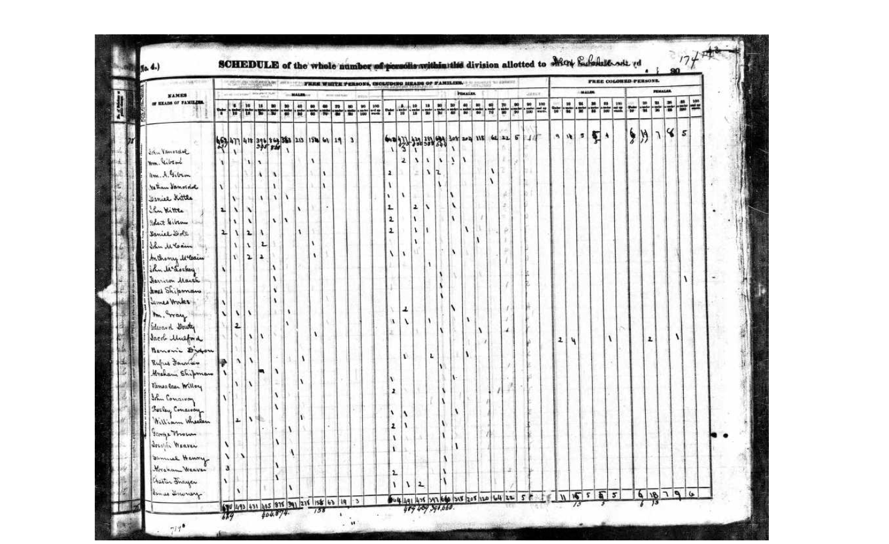
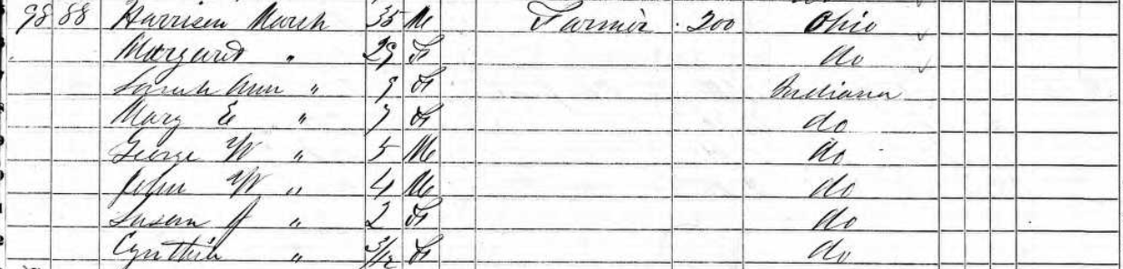
STEP 4: Census Records
1840 Census – Dearborn County, IN
1850 Census – Cass County, IN

Slide 31
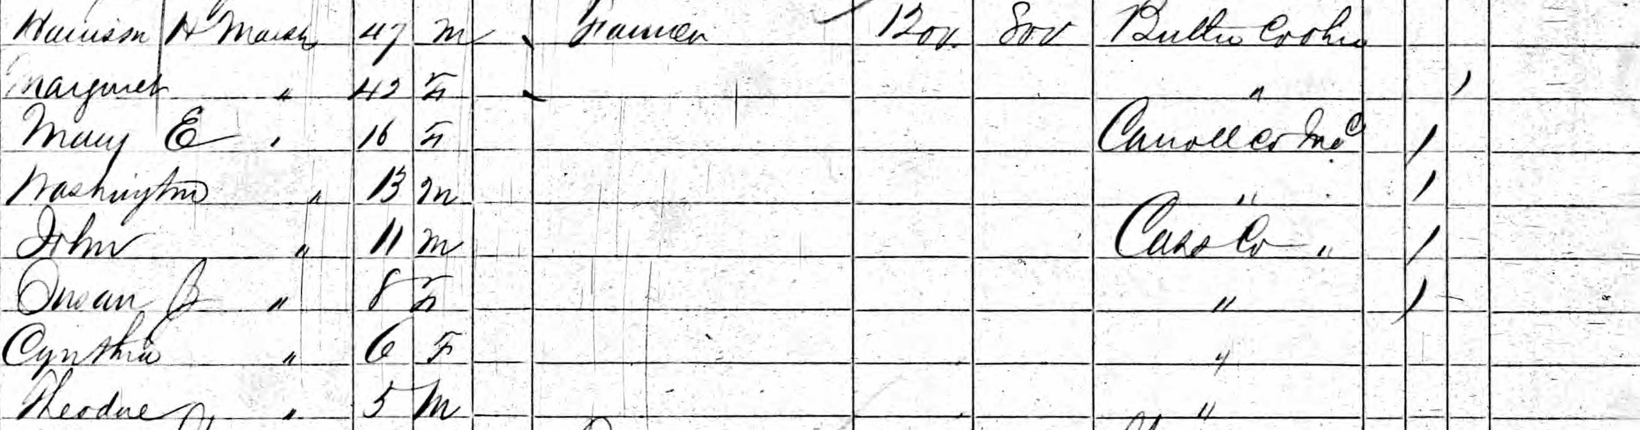
STEP 4: Census Records
1860 Census – Cass County, IN

Slide 32
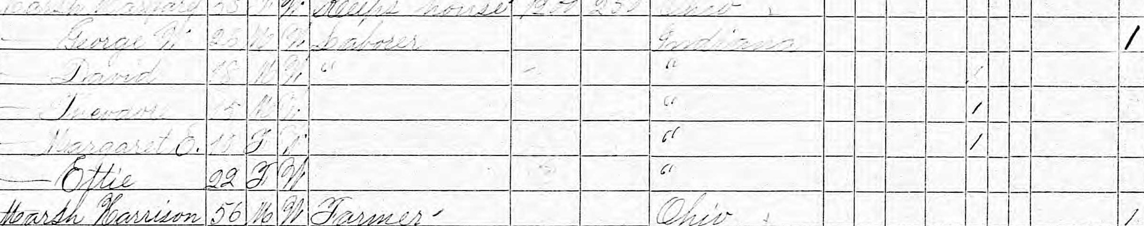
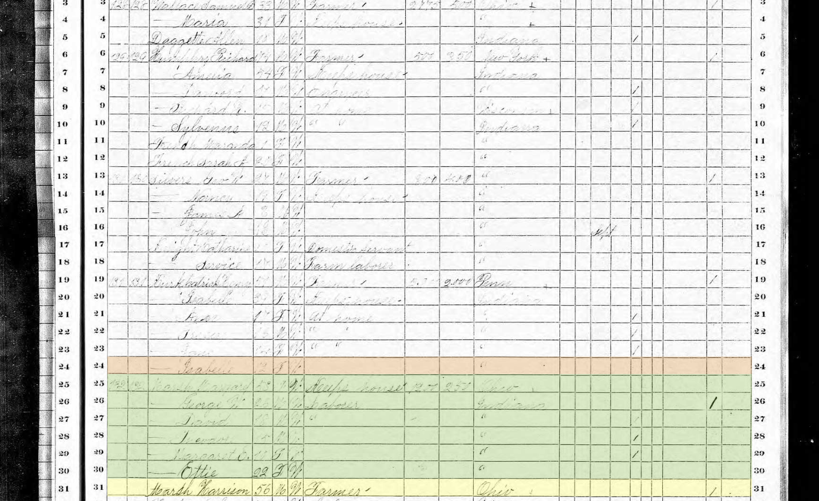
STEP 4: Census Records
1870 Census – Cass County, IN

Slide 33
STEP 4: Find A Grave

Slide 34
STEP 4: Family Group Sheet

Slide 35
STEP 4: Spreadsheet Entries
Notes:
All of these records show George W. and Cynthia as children of Harrison Marsh and Margaret (Harper) Marsh. The problem arises when we get the 1870 Census that has George W. and Ettie Marsh living with his parents. Wrong wife!! I then went looking for records of George W. and Ettie Marsh and entered all of their information in the next columns.

Slide 36
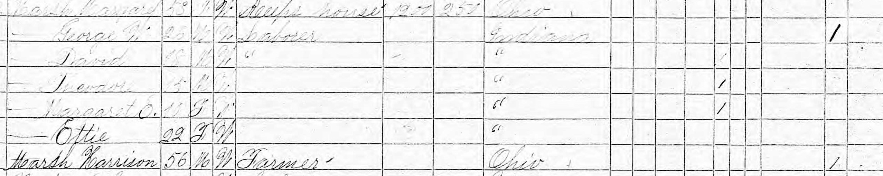
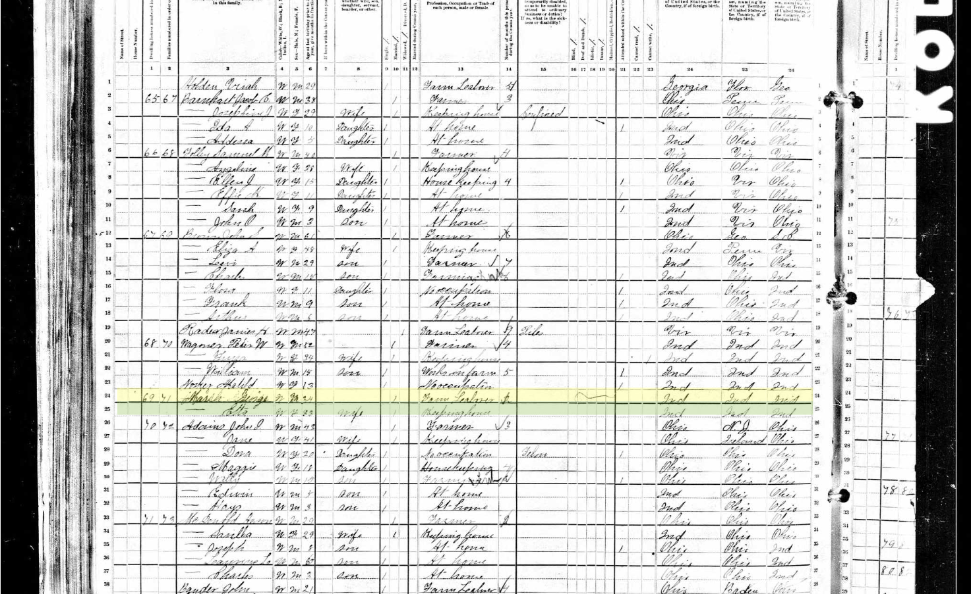
STEP 5: Records for George & Ettie Marsh
1870 Census – Cass County, IN

Slide 37
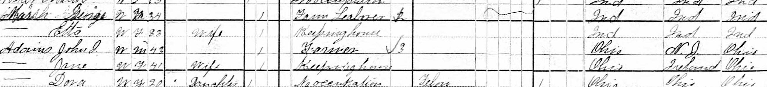
STEP 5: Census Records
1880 Census – Howard County, IN

Slide 38
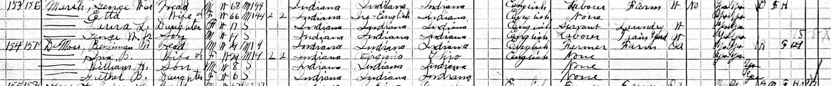
STEP 5: Census Records
1900 Census – Howard County, IN
1910 Census – Howard County, IN

Slide 39
STEP 5: U. S. City Directories
1921 – Logansport, Cass County, IN

Slide 40
STEP 5: U. S. City Directories
1930 – Logansport, Cass County, IN

Slide 41
STEP 5: U. S. Civil War Pension Index
Notes:
We have proven that Garrett Lafayette Marsh is the son of George Washington and Mariah (Walling) Marsh. We have proven that Cynthia Ann and George W. Marsh are the children of Harrison and Margaret (Harper) Marsh.
The questions are:
If the Uncle George who traveled with Garrett Lafayette Marsh to Indiana in 1925 is the George married to Mariah Walling , as the records indicate, how could he be identified as “Uncle” George?
Who are the parents of George Washington Marsh?

